Slide 1

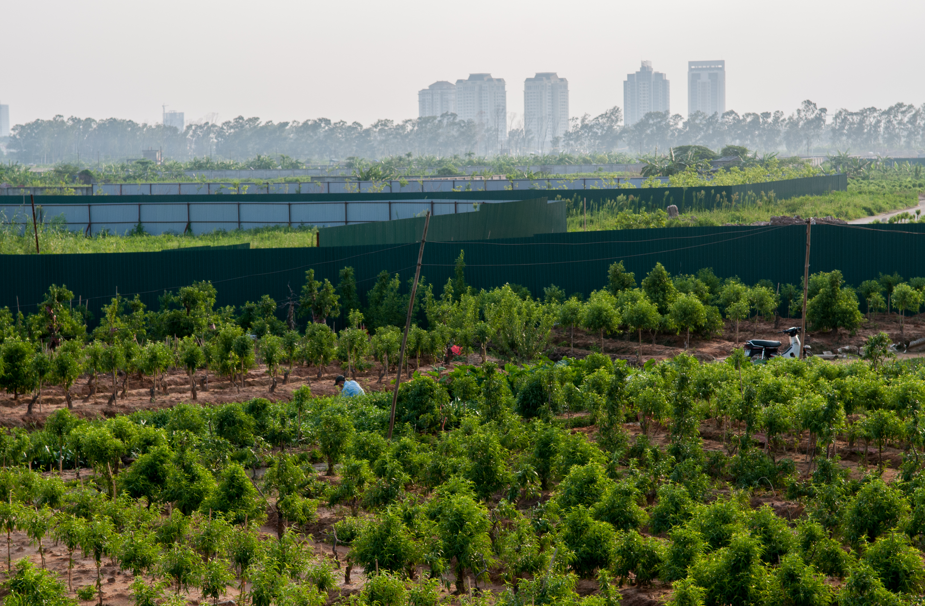



Data-Driven Self-Supervised Machine Learning for Classifying Urban Environments
- Addis Ababa, 2024
Jemima O’Farrell
1st December 2025
https://ecofoodsystems.org/ |
@EcoFoodSystems |
EcoFoodSystems

Slide 2
Why Mapping Cities Matters
Take stock of urban & peri-urban farming, which
Shortens supply chains
Boosts food system resilience
Improves access to fresh healthy foods
Reduces the footprint of a diverse diet
Creates green jobs
Monitor urban sprawl and the impact on production zones and green spaces.
Improving spatial health-risk analysis and our understanding of how urban environments shape our diets

Slide 3
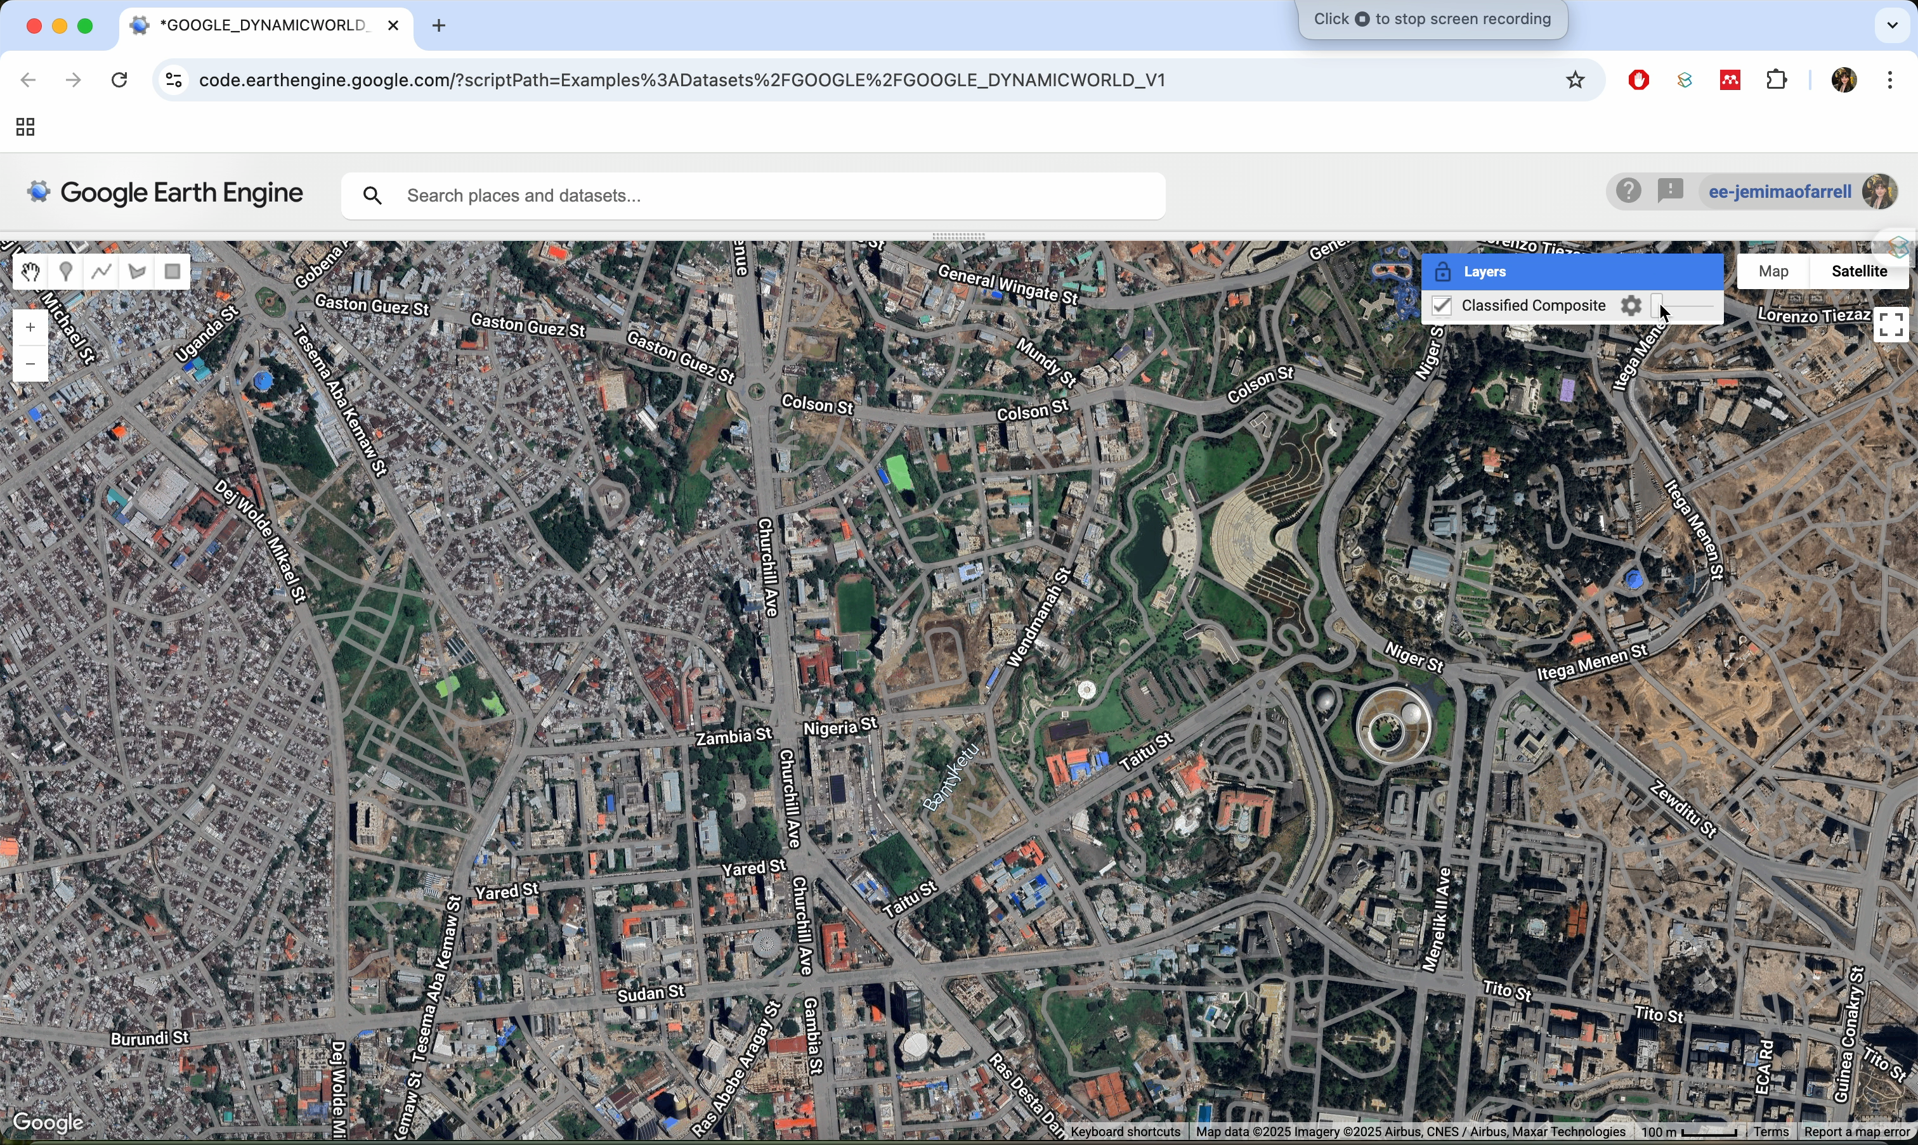
The Achilles’ Heel of Global Land-Cover Maps
Popular global land cover (GLC) maps by Google, ESRI and ESA range in reported accuracy from 73.8-85%
This accuracy drops drastically in fragmented areas, especially urban and peri-urban landscapes.
GLC maps often lose the fine-scale land-use diversity that make up trees, gardens, small farms and empty plots.
“Jack of all trades, master of none”

Slide 4
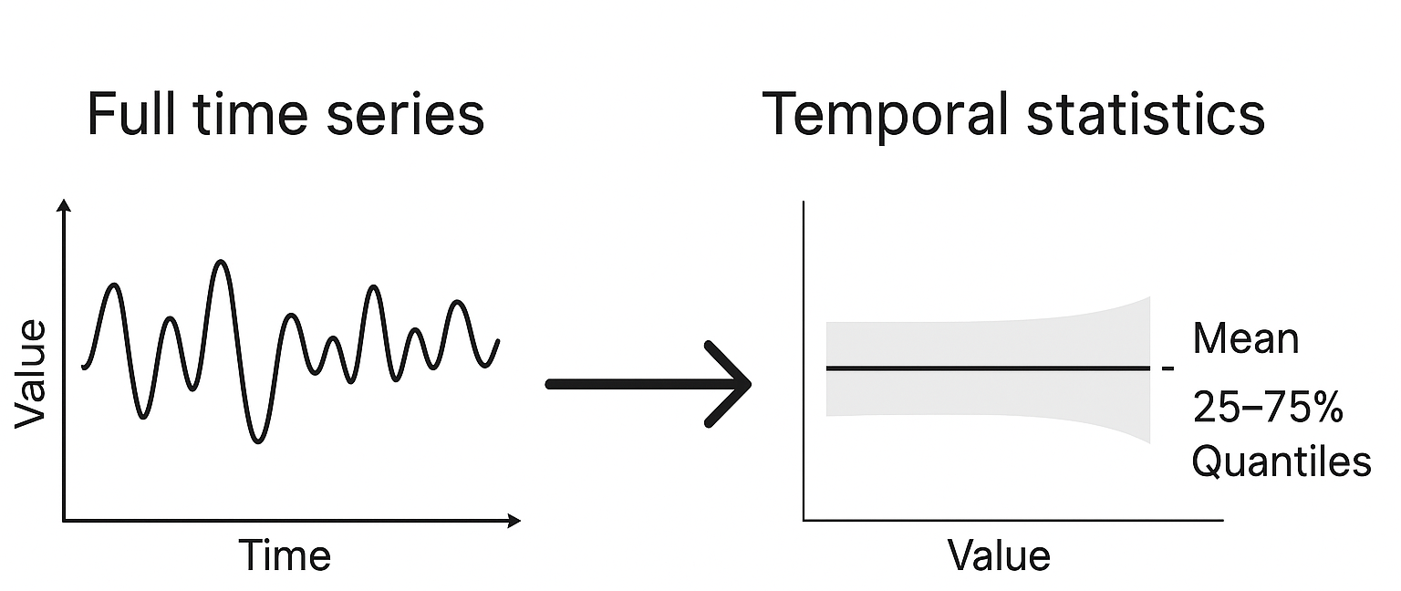
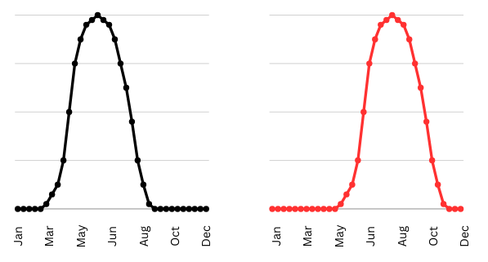
State of the Art
ESA currently prepares it’s input data by generating temporal statistics (mean, standard deviation, quantiles), paired with a simple machine learning classifier.
This data compression is required at global scale but we lose information on when those seasonal changes occur
ESRI and Google classify per scene with a deep learning algorithm and aggregate those classifications into one annual composite.
Additionally, the manually labelled training data for ESRI and Google are labelled in 50m x 50m units, so despite claims that the resolution of the final dataset is 10m, there are artifacts of this course resolution in the final results.
Figure 1. Infographic demonstrating the compression of data through temporal statistics

Slide 5
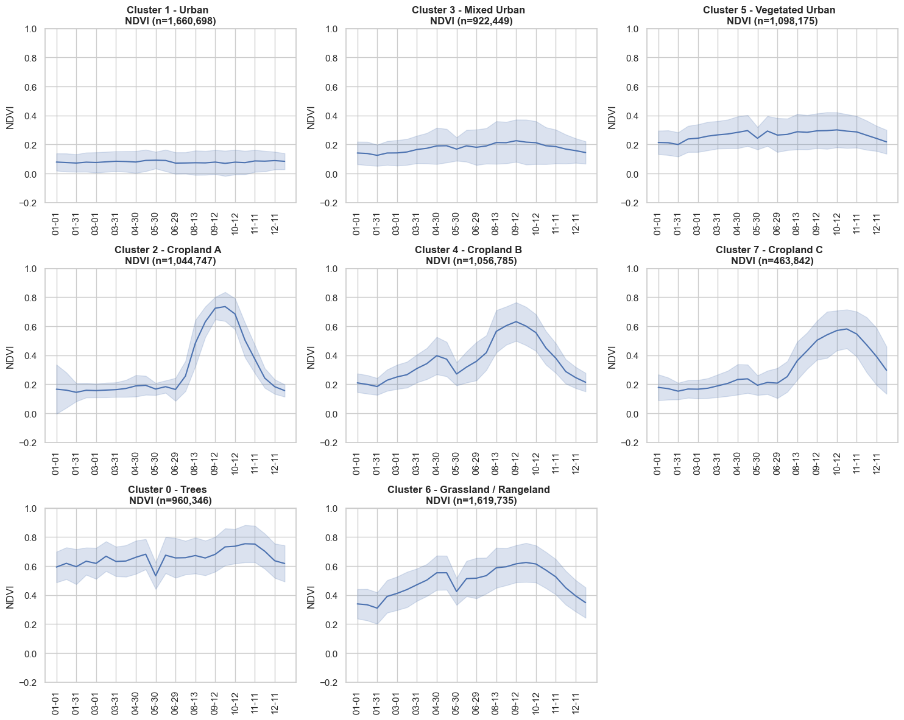
Introducing Time-Series Clustering
Because global products compress and oversimplify the signal, we propose working directly with the full time-series
The input data is a timeseries of biweekly (every 2-weeks) Sentinel-1/2 derived indicators covering a range of targets eg. NDVI for vegetation, NDBI for Built-Area, mNDWI for water etc.
The self-supervised clustering algorithm is purely data-driven and decides how many distinct groups of pixels there is in the data.
This means that the result is unlabelled and requires further inspection to assign appropriate labels.
Figure 2. Median timeseries for each cluster +/- 1 standard deviation

Slide 6
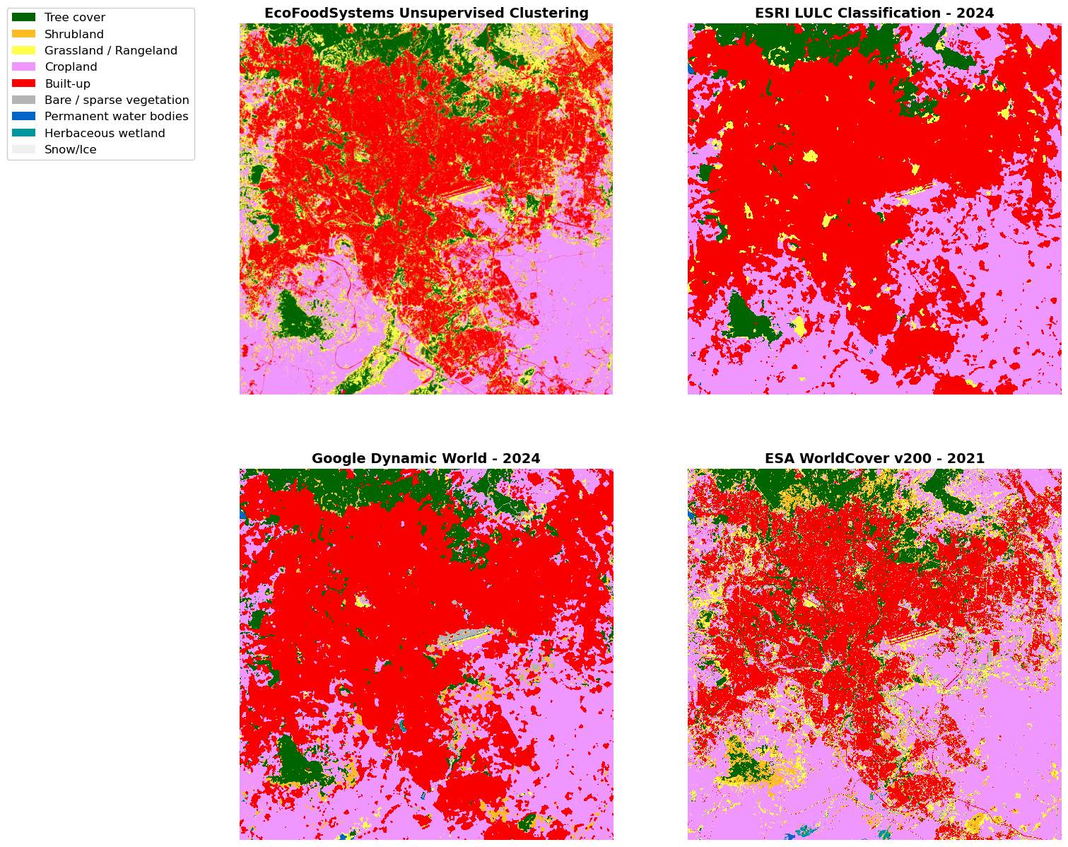
Comparison with Global GLC Data
It’s clear from visual interpretation of the Google Dynamic World and ESRI classifications that they were training on 50m x 50m labels, resulting in overly homogeneous areas lacking spatial detail.
ESA WorldCover v200 does capture spatial detail effectively but unlike the other datasets, is a one off LULC product and therefore cannot capture land-use change.
Figure 3. Results plotted against 3 major 10m resolution GLC datasets, common labels were applied to all for ease of comparison.

Slide 7
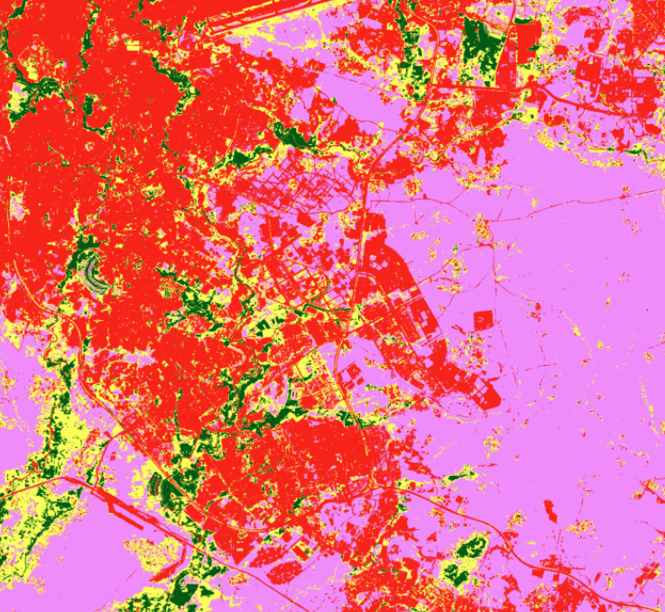
Comparison with Global GLC Data
Figure 3. Results plotted against 3 major 10m resolution GLC datasets, common labels were applied to all for ease of comparison.

Slide 8
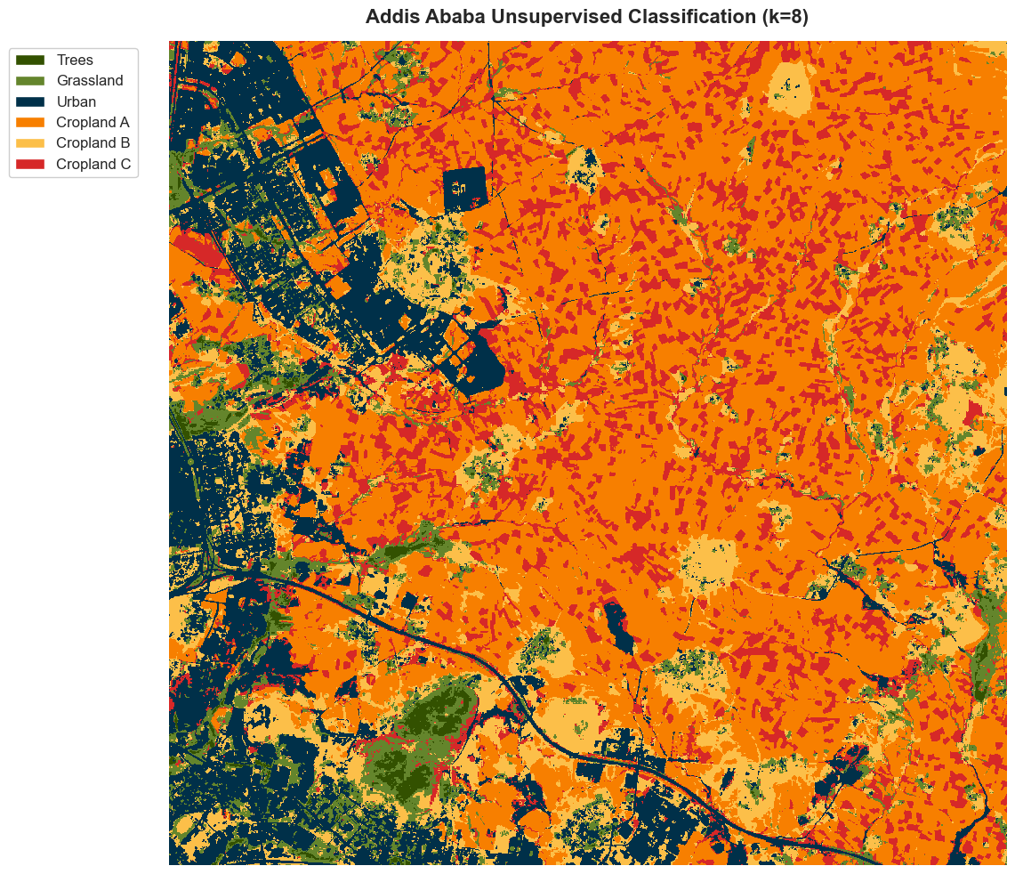
Disaggregating Crops by Phenology
Here we can see the that by classifying regions by timeseries reveals distinct seasonal differences in the data
In red we see a crop planted early July that is harvested in January the following year
In orange we see a different crop that is also planted in July but is harvested much earlier around November.
Finally, in yellow we see what looks like two separate
Figure 2. Median timeseries for each cluster +/- 1 standard deviation
Figure 4. Sample square from results disaggregating by crop-type

Slide 9
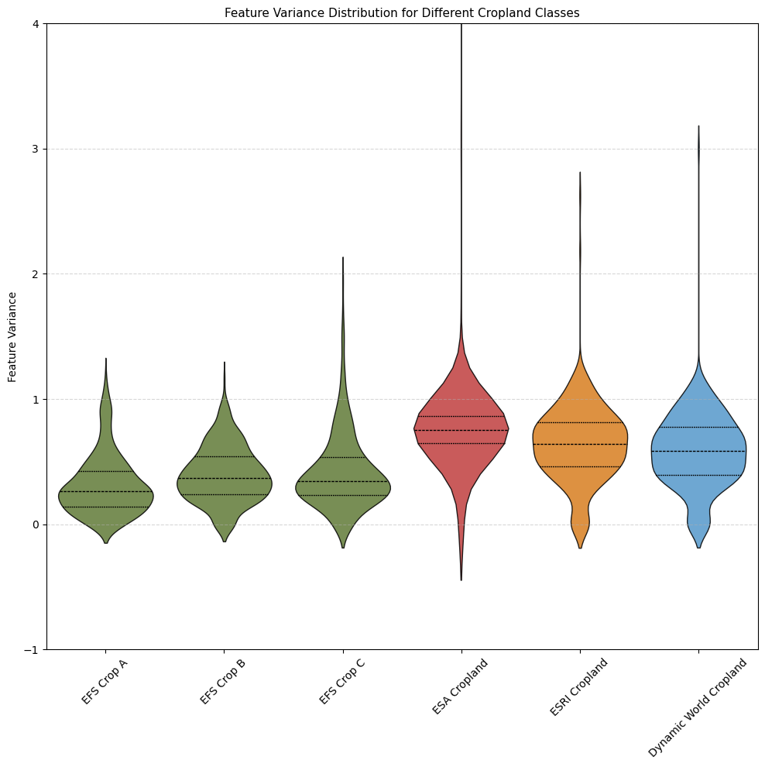
Comparing the Variance with Classes
Within each general cropland class for the comparison datasets, we observe significantly higher feature variance.
The average variance in the ESA cropland map (0.7988) is double the average variance in the EFS crop classes (0.317-0.42)
Lower variance means tighter and more meaningful classes that capture coherent land-cover types.
Figure 6. Violin plot of all 353 ‘features’ variance for each cropland class across products

Slide 10
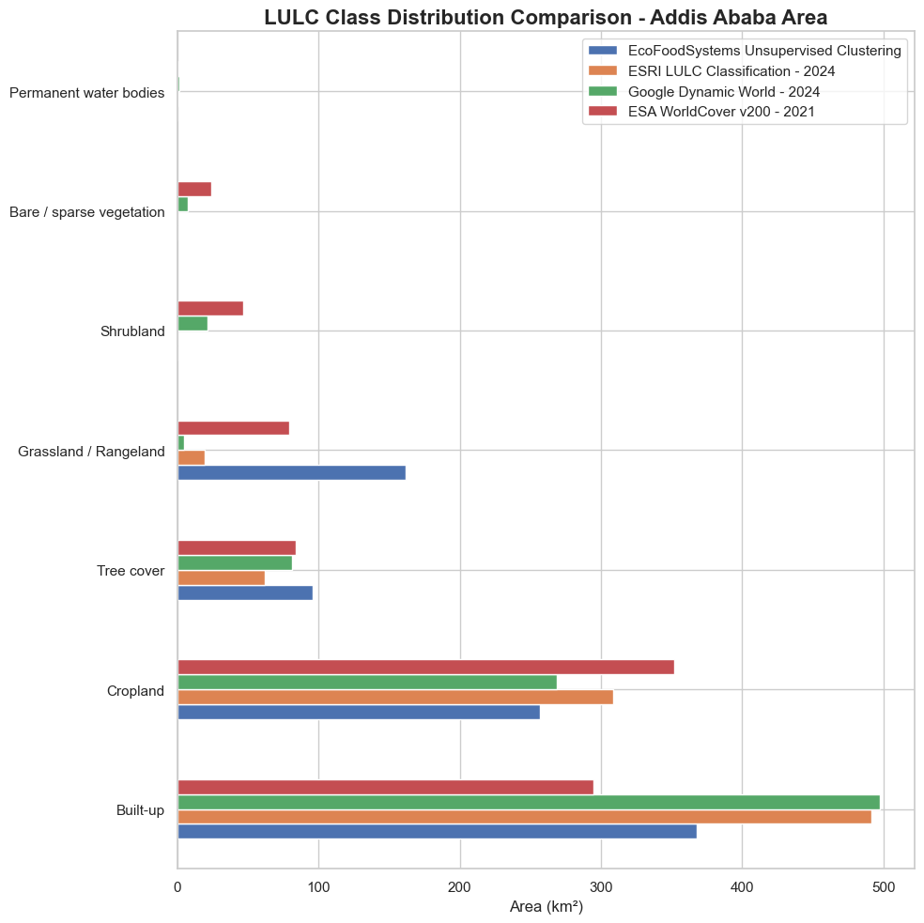
Sum of the Difference
As reported in 2021 ^{[1]} , the built-up area of Addis Ababa is estimated at ~364.5 km² by an external independent analysis
This strongly supports the EFS estimate of 368.1 km²
As a contextual benchmark this also supports the observation that the course homogeneity of GLC products from Google and ESRI is causing overestimations of (up to ~35%) of built-up area
Product | Built-Up (km²)
EFS Self-Supervised | 368.1
ACRC Benchmark | 364.5
ESA WorldCover 2021 | 294.7
ESRI LULC 2024 | 491.9
Google Dynamic World 2024 | 497.4
[1] - Wekdeghebrael, E.H. (2021) ADDIS ABABA: CITY SCOPING STUDY. tech. African Research Consortium, pp. 4–5.
Figure 6. Total area in square-kilometres for major land-cover types

Slide 11
Key Takeaways
Urban and Peri-Urban regions are extremely heterogeneous and require data-driven tailored approaches to accurately resolve this level of detail
Time-series self-supervised clustering alleviates the burden of training data
Next Steps
Refine the classification to separate perennial crops from forestry and shrubland
Process data to repeat the analysis from 2020-2025 to observe any trends in land-use change
Match crop phonologies to labelled samples from ECT2020 produced by CIMMYT Ethiopia

